Slide 1
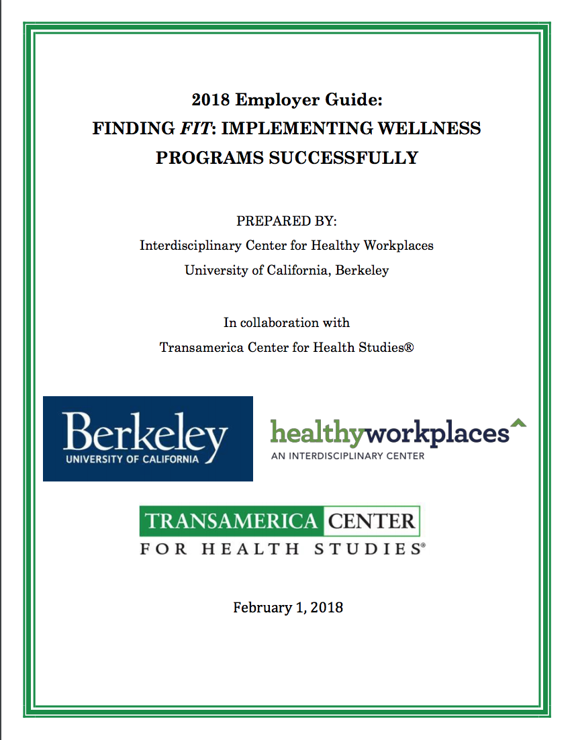
How to Increase Wellness Program Adoption and Employee Participation
Using Principles of Psychology
Cristina Banks, PhD
Director, Interdisciplinary Center for Healthy Workplaces,
University of California, Berkeley
cbanks@berkeley.edu

Slide 2
Talk Summary
Wellness Programs cannot be treated as a single entity.
Wellness Programs differ along several important dimensions—leadership support is the most important.
Adoption of Wellness Programs can increase when there is a good “fit” with organizational.
Participation rates can increase when there is a match between employee needs and wellness program characteristics.
Treat wellness program adoption like good employee selection.

Slide 3

The Project
Funded by Transamerica Center for Health Studies (TCHS)
Three questions to answer:
How to...
...increase adoption rates of effective wellness programs?
...increase participation in wellness programs?
...do this with small and medium-sized organizations?

Slide 4


Our Approach:
Scientist-Practitioner Model
Notes:
<div>Icons made by <a href="https://www.flaticon.com/authors/turkkub" title="turkkub">turkkub</a> from <a href="https://www.flaticon.com/" title="Flaticon">www.flaticon.com</a> is licensed by <a href="http://creativecommons.org/licenses/by/3.0/" title="Creative Commons BY 3.0" target="_blank">CC 3.0 BY</a></div>
<div>Icons made by <a href="http://www.freepik.com" title="Freepik">Freepik</a> from <a href="https://www.flaticon.com/" title="Flaticon">www.flaticon.com</a> is licensed by <a href="http://creativecommons.org/licenses/by/3.0/" title="Creative Commons BY 3.0" target="_blank">CC 3.0 BY</a></div>
<div>Icons made by <a href="http://www.freepik.com" title="Freepik">Freepik</a> from <a href="https://www.flaticon.com/" title="Flaticon">www.flaticon.com</a> is licensed by <a href="http://creativecommons.org/licenses/by/3.0/" title="Creative Commons BY 3.0" target="_blank">CC 3.0 BY</a></div>

Slide 5
Scientist Questions:
How effective are wellness programs?
What wellness programs are the most effective?
What factors affect the adoption of a wellness program?
What are the participation rates in different wellness programs?
What factors affect participation rates in wellness programs?
Notes:
<div>Icons made by <a href="https://www.flaticon.com/authors/turkkub" title="turkkub">turkkub</a> from <a href="https://www.flaticon.com/" title="Flaticon">www.flaticon.com</a> is licensed by <a href="http://creativecommons.org/licenses/by/3.0/" title="Creative Commons BY 3.0" target="_blank">CC 3.0 BY</a></div>
<div>Icons made by <a href="http://www.freepik.com" title="Freepik">Freepik</a> from <a href="https://www.flaticon.com/" title="Flaticon">www.flaticon.com</a> is licensed by <a href="http://creativecommons.org/licenses/by/3.0/" title="Creative Commons BY 3.0" target="_blank">CC 3.0 BY</a></div>

Slide 6
Practitioner Questions:
What are the facilitators of wellness program adoption?
What are the barriers to wellness program adoption?
What are the facilitators of wellness program participation?
What are the barriers to wellness program participation?
What psychological principles can be applied to increase adoption rates?
What psychological principles can be applied to increase participation rates?
What psychological principles facilitate behavior change?
Notes:
<div>Icons made by <a href="https://www.flaticon.com/authors/turkkub" title="turkkub">turkkub</a> from <a href="https://www.flaticon.com/" title="Flaticon">www.flaticon.com</a> is licensed by <a href="http://creativecommons.org/licenses/by/3.0/" title="Creative Commons BY 3.0" target="_blank">CC 3.0 BY</a></div>
<div>Icons made by <a href="http://www.freepik.com" title="Freepik">Freepik</a> from <a href="https://www.flaticon.com/" title="Flaticon">www.flaticon.com</a> is licensed by <a href="http://creativecommons.org/licenses/by/3.0/" title="Creative Commons BY 3.0" target="_blank">CC 3.0 BY</a></div>

Slide 7
Solving the Problem of Adoption and Participation Rates
What framework will…
...provide employers the best chance of having a successful wellness program?
...provide employees the best chance of long-lasting behavior change while participating in a wellness program
Notes:
<div>Icons made by <a href="https://www.flaticon.com/authors/turkkub" title="turkkub">turkkub</a> from <a href="https://www.flaticon.com/" title="Flaticon">www.flaticon.com</a> is licensed by <a href="http://creativecommons.org/licenses/by/3.0/" title="Creative Commons BY 3.0" target="_blank">CC 3.0 BY</a></div>
<div>Icons made by <a href="http://www.freepik.com" title="Freepik">Freepik</a> from <a href="https://www.flaticon.com/" title="Flaticon">www.flaticon.com</a> is licensed by <a href="http://creativecommons.org/licenses/by/3.0/" title="Creative Commons BY 3.0" target="_blank">CC 3.0 BY</a></div>

Slide 8
The Scientist Role:
Literature review of wellness program effectiveness and factors related to adoption and participation rates.
Identification of factors that drive success and failure of wellness programs.
Notes:
<div>Icons made by <a href="https://www.flaticon.com/authors/turkkub" title="turkkub">turkkub</a> from <a href="https://www.flaticon.com/" title="Flaticon">www.flaticon.com</a> is licensed by <a href="http://creativecommons.org/licenses/by/3.0/" title="Creative Commons BY 3.0" target="_blank">CC 3.0 BY</a></div>
<div>Icons made by <a href="http://www.freepik.com" title="Freepik">Freepik</a> from <a href="https://www.flaticon.com/" title="Flaticon">www.flaticon.com</a> is licensed by <a href="http://creativecommons.org/licenses/by/3.0/" title="Creative Commons BY 3.0" target="_blank">CC 3.0 BY</a></div>

Slide 9
Adoption Rates of Wellness Programs
Adoption Rates of Wellness Programs
All organizations: 55.2%
Small organizations (1-49): 24.7%
Medium organizations (50-499): 76.9%
Large organizations (500+): 82.6%
Employee Report vs. Employer Report: Employees report lower rates
Small organizations: 17.1%
Medium organizations: 41.5%
Large organizations: 52.9%
Highest Reported Participation Rates in Wellness Programs
Participation levels were <10%, 11-20%, 21-40%, 41-50%, >50%
Small organizations: >50%
Medium organizations: 21-40%
Large organizations: 41-50%

Slide 10
Participation Rates
Highest Reported Participation Rates in Wellness Programs
(Participation levels were <10%, 11-20%, 21-40%, 41-50%, >50%)
Small organizations: >50%
Medium organizations: 21-40%
Large organizations: 41-50%
Low participation = Poor test of wellness program effectiveness

Slide 11
Literature Review Results
Examined studies by program type and that reported participation rates
Poor representation of small to medium-sized companies
Identified facilitators and barriers to wellness program adoption and participation reported in studies
Participation rates are highest among the group that intended to participate and then completed the program.

Slide 12
Conclusions from Data Collection
Wellness programs vary in significant ways
Highest completion rates when employees indicated an interest in participating in them.
Most effective ones have targeted subjects, very specific behavior targets, use incentives, are short term
Leadership commitment and involvement are key to successful adoption of wellness programs in general
Notes:
<div>Icons made by <a href="https://www.flaticon.com/authors/turkkub" title="turkkub">turkkub</a> from <a href="https://www.flaticon.com/" title="Flaticon">www.flaticon.com</a> is licensed by <a href="http://creativecommons.org/licenses/by/3.0/" title="Creative Commons BY 3.0" target="_blank">CC 3.0 BY</a></div>
<div>Icons made by <a href="http://www.freepik.com" title="Freepik">Freepik</a> from <a href="https://www.flaticon.com/" title="Flaticon">www.flaticon.com</a> is licensed by <a href="http://creativecommons.org/licenses/by/3.0/" title="Creative Commons BY 3.0" target="_blank">CC 3.0 BY</a></div>

Slide 13
The Practitioner Role:
19 Organizations representing multiple industries and geographies
1 to 3 focus groups conducted in each organization, 2 to 8 participants in each focus group (total N = 162)
Leadership/Managers: 65
HR: 30
Employees: 67
Topics:
Wellness programs implemented
Facilitators
Barriers
Notes:
<div>Icons made by <a href="https://www.flaticon.com/authors/turkkub" title="turkkub">turkkub</a> from <a href="https://www.flaticon.com/" title="Flaticon">www.flaticon.com</a> is licensed by <a href="http://creativecommons.org/licenses/by/3.0/" title="Creative Commons BY 3.0" target="_blank">CC 3.0 BY</a></div>
<div>Icons made by <a href="http://www.freepik.com" title="Freepik">Freepik</a> from <a href="https://www.flaticon.com/" title="Flaticon">www.flaticon.com</a> is licensed by <a href="http://creativecommons.org/licenses/by/3.0/" title="Creative Commons BY 3.0" target="_blank">CC 3.0 BY</a></div>

Slide 14
Focus Group Findings: Small Organizations
Wellness Programs offered in small organizations:
Healthy food/drink offerings in-house (cafeteria, vending, free) (N=2)
Social engagement (social clubs, interest groups, sports teams) (N=5)
Links to related employee services for support with personal issues (referral to employee assistance programs--EAP) (N=2)
Ergonomic furniture/equipment (N=4)
Fitness gym facilities or outdoors exercise areas (N=2)
Notes:
<div>Icons made by <a href="https://www.flaticon.com/authors/turkkub" title="turkkub">turkkub</a> from <a href="https://www.flaticon.com/" title="Flaticon">www.flaticon.com</a> is licensed by <a href="http://creativecommons.org/licenses/by/3.0/" title="Creative Commons BY 3.0" target="_blank">CC 3.0 BY</a></div>
<div>Icons made by <a href="http://www.freepik.com" title="Freepik">Freepik</a> from <a href="https://www.flaticon.com/" title="Flaticon">www.flaticon.com</a> is licensed by <a href="http://creativecommons.org/licenses/by/3.0/" title="Creative Commons BY 3.0" target="_blank">CC 3.0 BY</a></div>

Slide 15
Focus Group Findings: Medium Organizations
Health education by providing information promoting health in general (N=4)
Health advice from a qualified vendor for promoting healthy behavior (N=5)
Individual mental or physical health tracking through a wearable device or online program (N=2)
Targeted behavior change programs for high risk employees (N=2)
Healthy food/drink offerings in-house (N=8)
Clinical screenings and biometric assessments (HRA) (N=4)
Social engagement (N=10)
Mindfulness, meditation, yoga, relaxation training (N=8)
Links to related employee services for support with personal issues (N=4)
Ergonomic furniture/equipment (N=9)
Subsidized gym memberships (N=2)
Fitness gym facilities or outdoors exercise areas (N=7)

Slide 16
Facilitators of Wellness Program Success
Wellness initiatives align with organizational constraints
Convenience
Reasonable work hours
Leadership understands the link between health and work outcomes
Leadership understands employee needs and preferences
Leadership support
Culture of health at work
WP appeals to personal preferences
Built environment designed for health and wellness
Strong communication system

Slide 17
Barriers to Wellness Program Success
Inconvenience
Nature of Work
Lack of clarity regarding the link between wellness programs and business outcomes
Concerns about funding
Leadership issues: attitudes towards wellness
Lack of experience with wellness
Perceived lack of need
Inaccurate perceptions of wellness program “failure”
Confusion about insurance
Lack of clear ownership
Lack of active and consistent leadership support
Lack of culture of health
Low morale
Lack of financial resources
Long work hours
Employees occupy multiple roles
Failure to take full advantage of insurance
Bureaucratic and logistical issues
Organization not self-insured
Poor communication
Concerns about liability

Slide 18
Conclusions from Focus Groups
Both the individual level and organization level factors were important in wellness program success.
Facilitators: employee readiness to participate, “fit” with the program, ability to participate.
Barriers: employee limitations on time available, no perceived need to change, nature of work prevents time out from work, leadership perceptions of participation, absence of a wellness champion.

Slide 19
What issues do we need to address?
Leadership support/involvement/commitment
Offering programs that are perceived as valuable
Making participation important.

Slide 20
Solution:
A “Fit” Model of Wellness Program Adoption
Key factor: Leadership involvement in wellness programs
Levels of involvement → adoption of wellness program type
Hierarchical Model of Organization Involvement

Slide 21
Finding Fit:
What are the different types of wellness programs and what do they require?

Slide 22
Education
Healthy Habit Development
(Enhanced)
Preventative Care Programs (Enhanced)
Social Community Building
- By the Employee
Healthy Habit Development
(Lite)
Social Community Building
- By the Organization
Preventative
Care Programs
(Lite)
Low
Disease Management Programs
Level of Employer Involvement
Wellness Program Types
High

Slide 23

Wellness Program Types:
Education
Notes:
Education Programs pursued by employees on their own outside of work. Examples are classes, lectures, podcasts, videos, and clubs/groups where employee learn about healthy behaviors and pursue them on their own.

Slide 24

Wellness Program Types:
Social Community Building by the Employee
Notes:
Social Community Building by the Employee where employees initiate in a grassroots manner a variety of social activities for the purpose of enhancing social relationships at work and experiencing more enjoyment in life with their peers.

Slide 25

Wellness Program Types:
Social Community Building by the Organization
Notes:
1. Social Community Building by the Organization where a member of the organization takes ownership of improving social community within the workforce. The organizational leader arranges social events at work and encourages development of clubs, interest groups, sports teams and all other manners of developing social connections with peers at work.

Slide 26
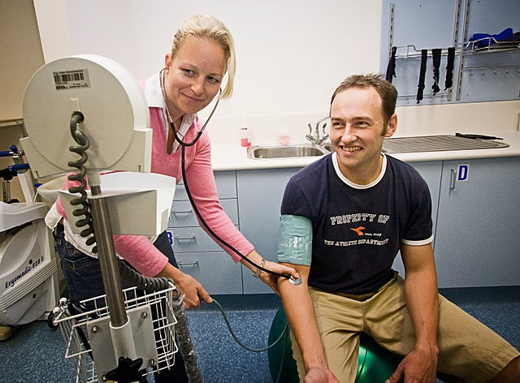
Wellness Program Types:
Preventative Care Program (Lite)
Notes:
Preventative Care Program (Lite) involves the health insurance vendor in performing health assessments and preventative screenings. Employee-specific recommendations are delivered to the employee at the organization in order to encourage illness and disease prevention.

Slide 27
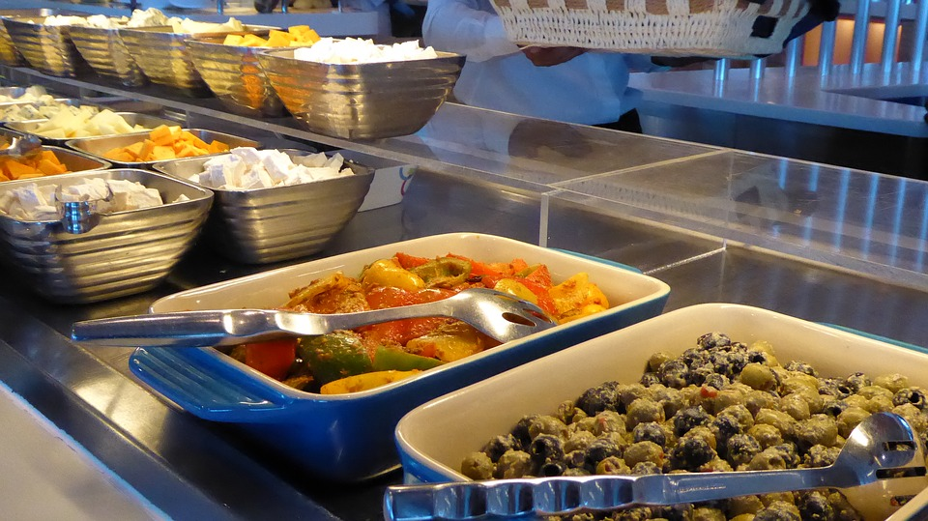
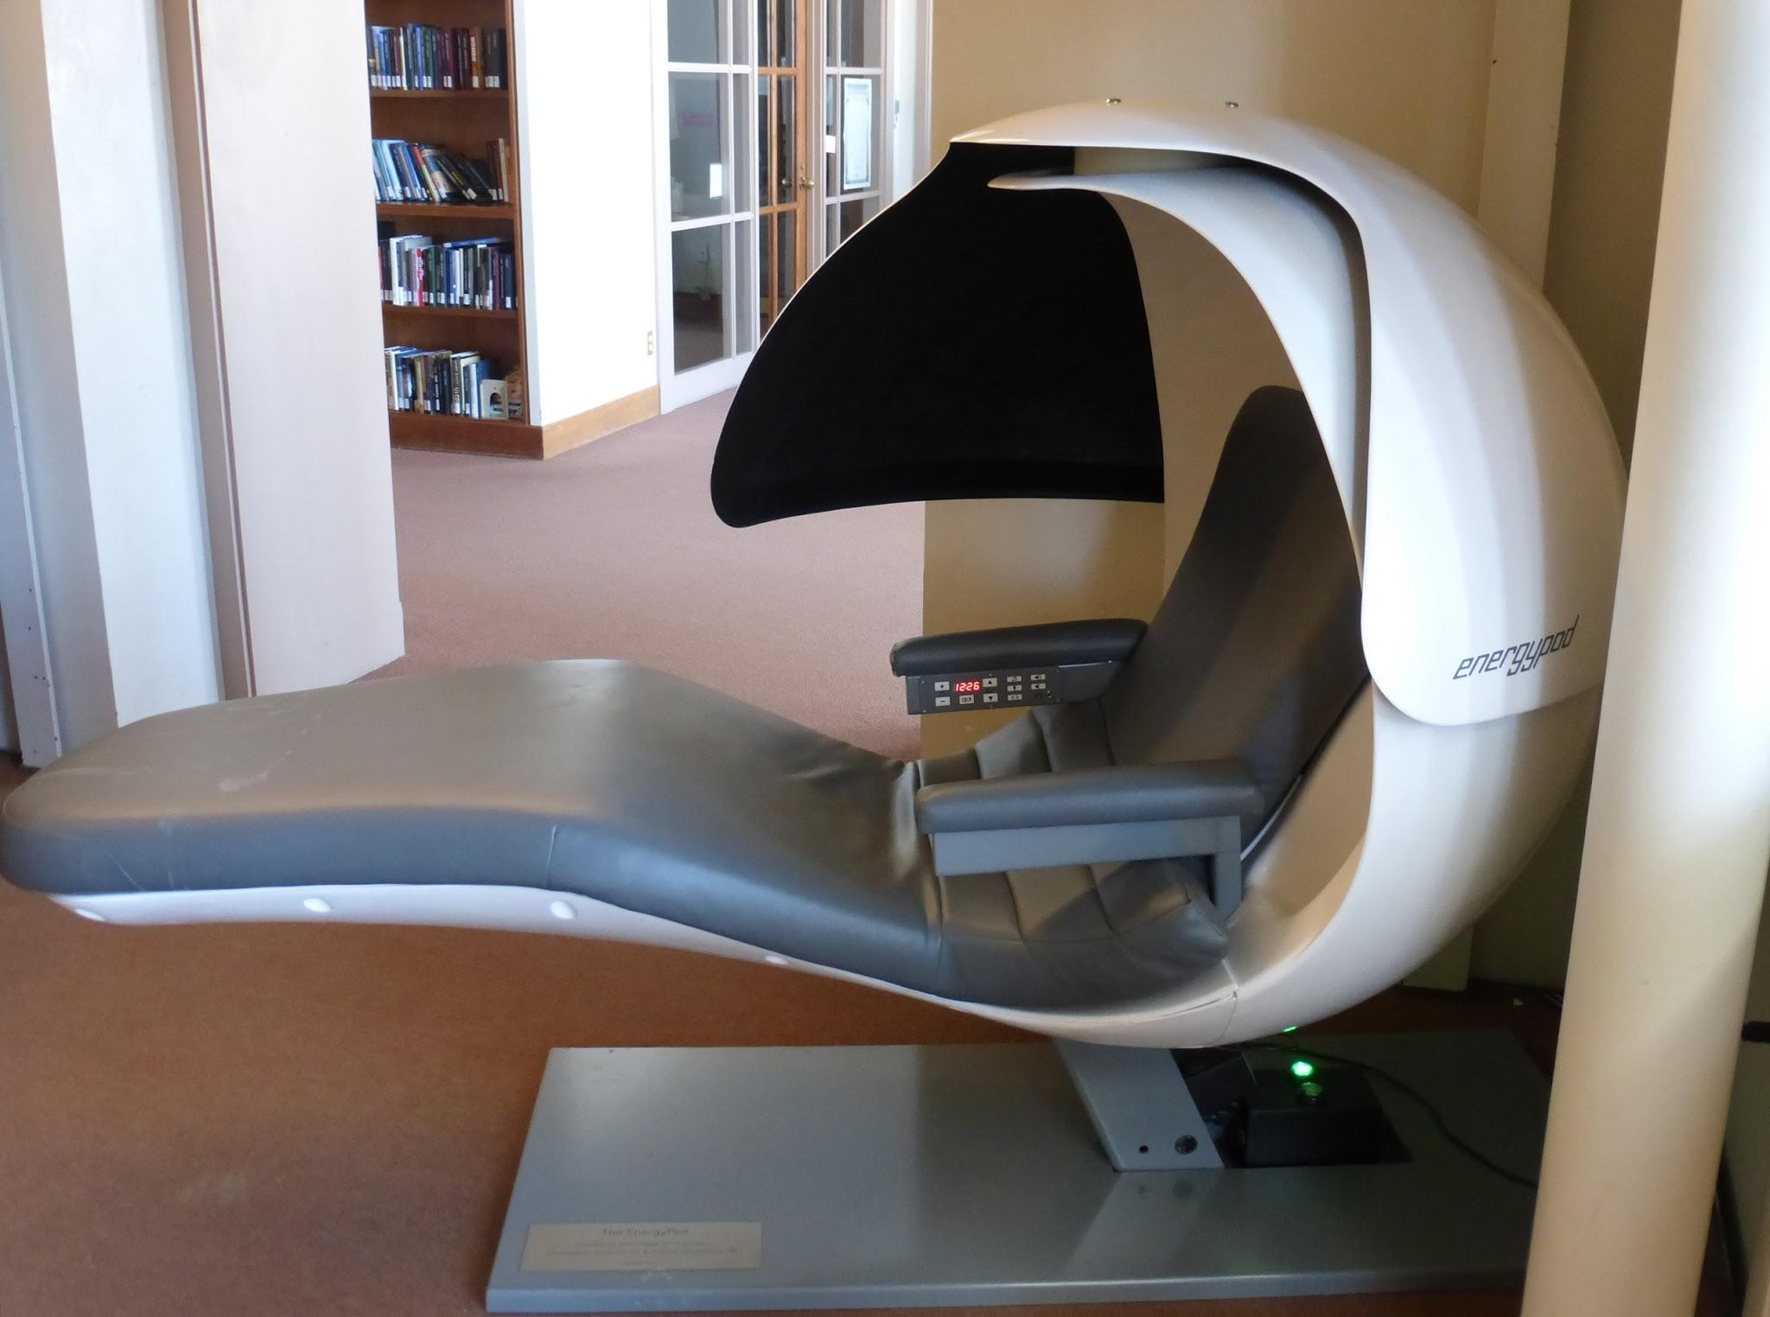
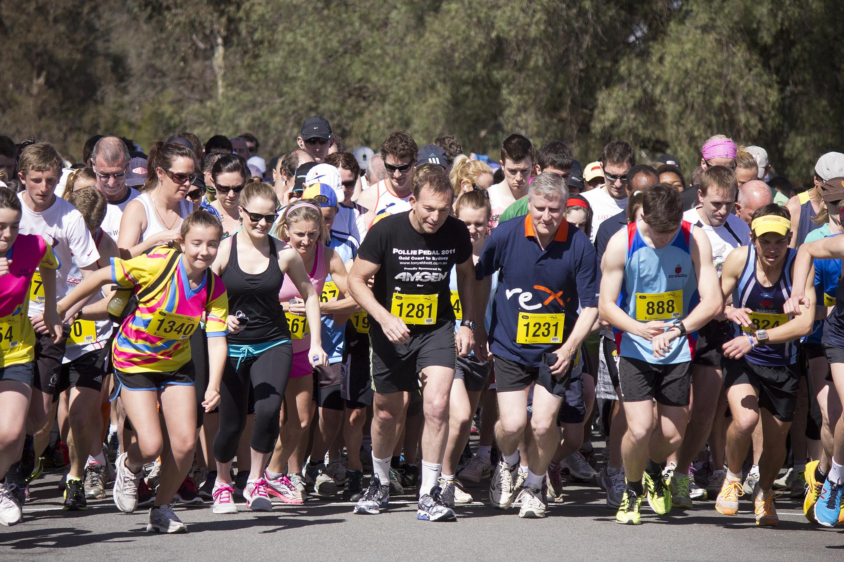
Wellness Program Types:
Healthy Habit Development (Lite)
Notes:
Healthy Habit Development (Lite) consists of a set of organization-led interventions in the workplace that encourage healthier eating, greater physical activity, tracking personal mental and physical health, and enjoying restoration. Examples of interventions are providing healthier food at work, organization-sponsored classes on-site, gym memberships, health tracking through wearable devices, and local health-related events such as “fun runs.”

Slide 28


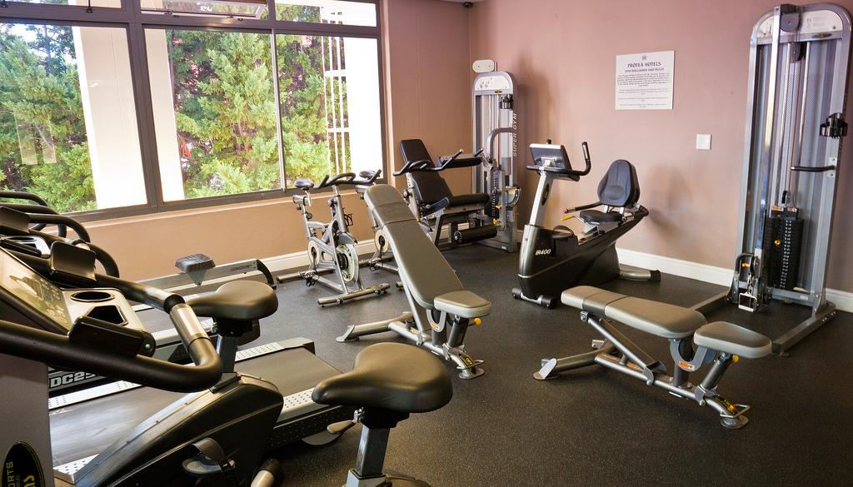
Wellness Program Types:
Healthy Habit Development (Enhanced)
Notes:
Healthy Habit Development (Enhanced) involves a much greater investment on the part of the leadership in making physical enhancements to the worksite to introduce healthier habits as a part of employees’ workday. Examples include building in-house gym facilities, in-house cafeterias with chef-made healthy meals, sports facilities with showers, attractive stairways, gardens and outdoor running paths, and workspace enhancements with natural light, temperature controls, good ventilation, non-toxic materials, and noise pollution controls. May also include HR policies that reduce stressors related to child/elder care, commuting and travel, and long work hours.

Slide 29
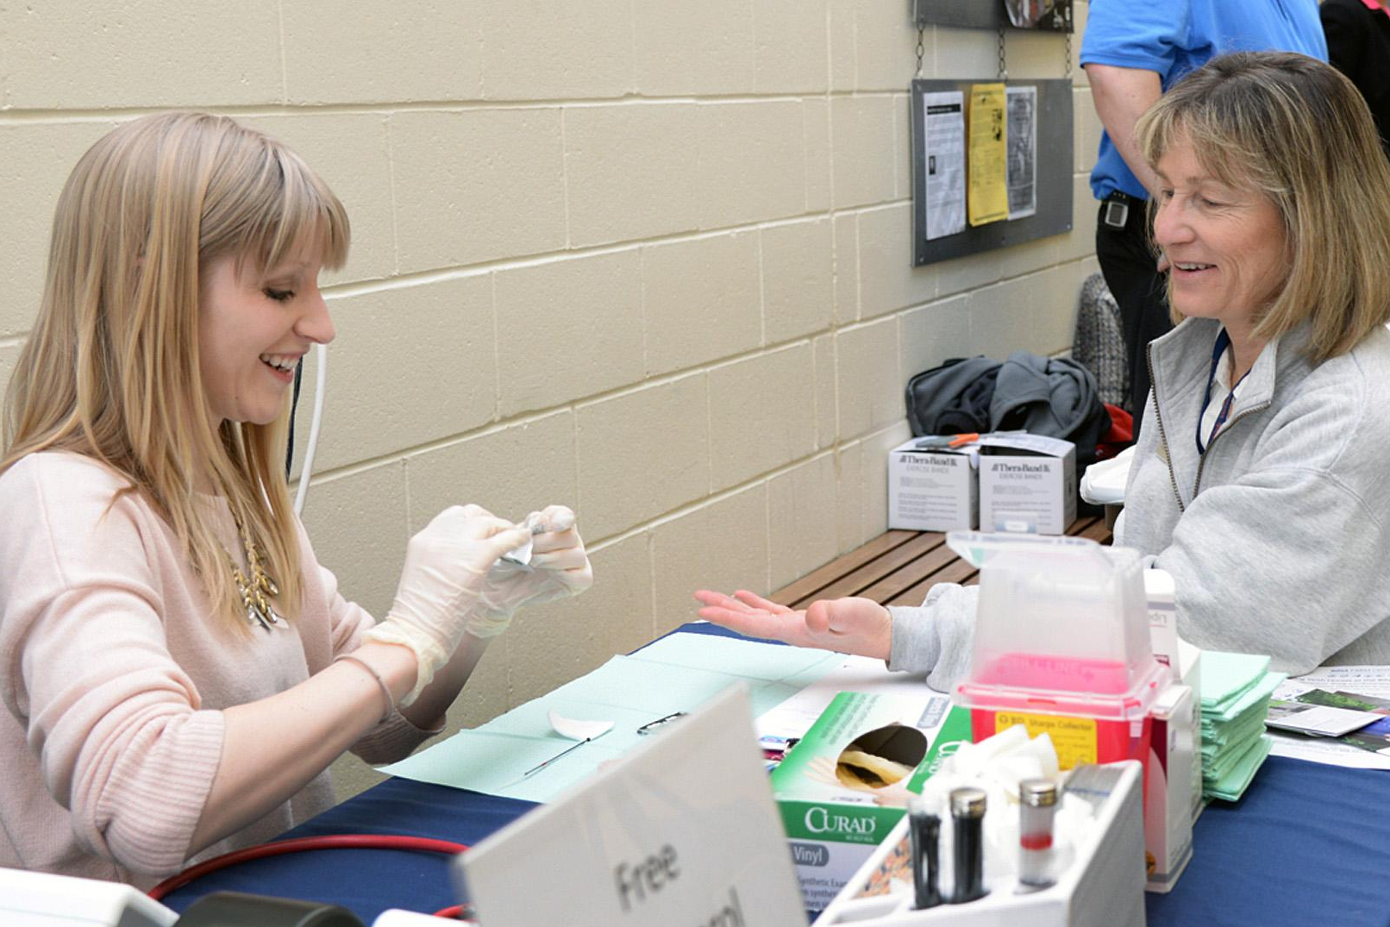
Wellness Program Types:
Preventative Care Program (Enhanced)
Notes:
Preventative Care Program (Enhanced) is a partnership between healthcare providers and organizational leadership in an effort to reduce the incidence of serious illness and disease. Wellness programs involve the integration of health promotion into the culture and organizational decision-making, and actively engages health professionals in coaching employees on disease prevention and health promotion. Also includes targeted programs (e.g., smoking cessation) for high-risk employees.

Slide 30
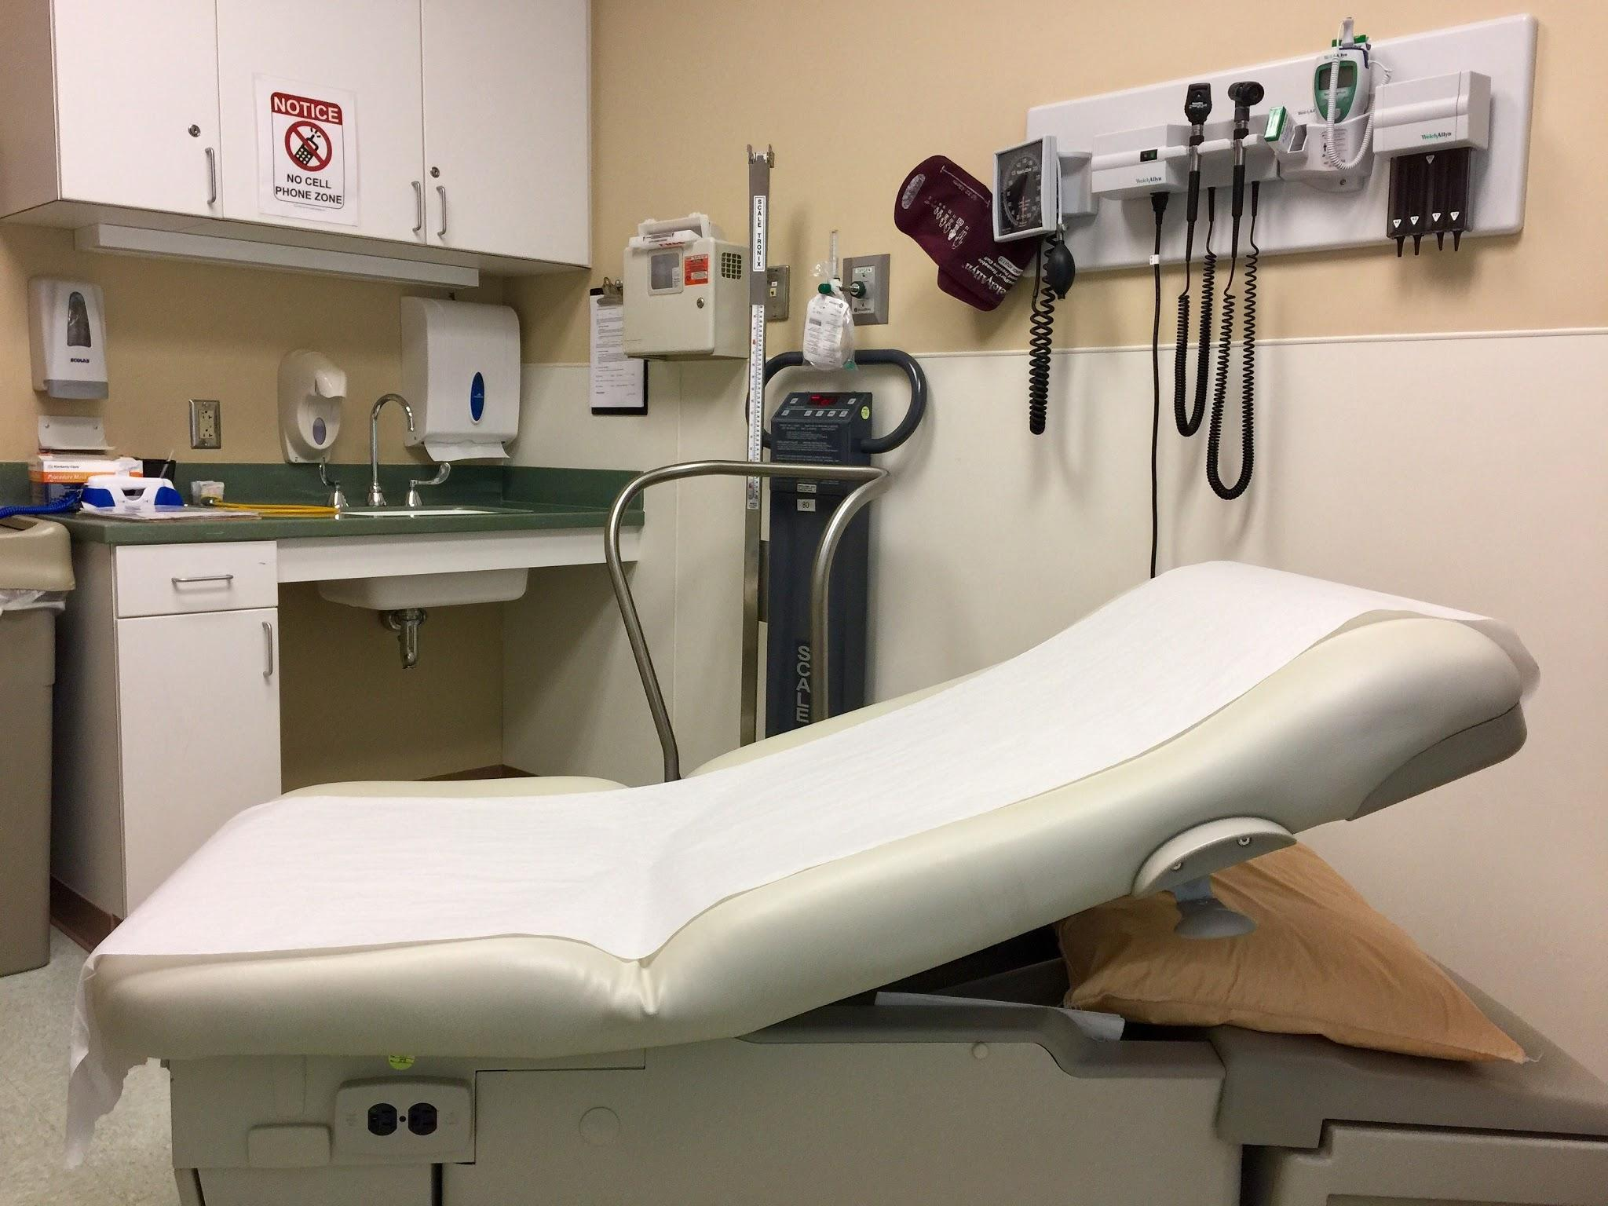
Wellness Program Types:
Disease Management
Notes:
Disease Management where the leadership makes significant investments in the establishment of in-house medical clinics and occupational health programs in order to service employees’ health needs and to treat employees who are sick, injured, or have active disease that needs consistent treatment and medication. The role of leadership is to ensure effective operation of the clinic and its programming to meet employees’ health needs.

Slide 31
Finding Fit:
What psychological principles can be applied to increase adoption?

Slide 32
Self-Assessment of Facilitators and Barriers

Slide 33

Facilitators:
Organization can afford to make financial investments to improve employee’s health and wellness.

Slide 34

Facilitators:
Leadership encourages employees to take time for their health.

Slide 35

Facilitators:
Employees can take time out from work to engage in healthy behaviors.

Slide 36

Facilitators:
Employees show their support for peers who make positive lifestyle changes.

Slide 37

Critical Barriers:
The organization lacks the financial resources to support wellness programs.

Slide 38

Critical Barriers:
There is a lack of physical facilities to incorporate wellness programs.

Slide 39


Critical Barriers:
There is a lack of ownership of wellness within the organization.

Slide 40

Critical Barriers:
Leadership fails to actively encourage employees to engage in wellness programs.

Slide 41
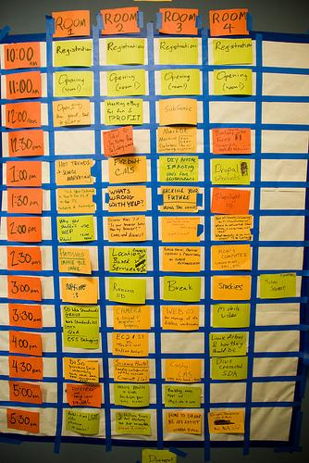
Critical Barriers:
Long Work Hours
are expected in
the organization.

Slide 42

Critical Barriers:
Employee Burnout

Slide 43
The Selection Model
Individual and organizational requirements
Wellness program characteristics
Match requirements to WP characteristics
Rank order the percentage of requirements met

Slide 44
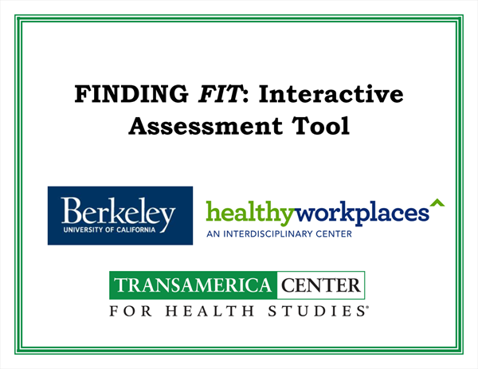

Slide 45


Slide 46
Finding Fit:
What psychological principles can be applied to increase participation?

Slide 47
What’s In It For Me?
WIFM

Slide 48
Motivation Theories:
Reinforcement Theory
Expectancy Theory
Early Behavioral Theory (Hawthorne Effect)
Goal Setting Theory
Notes:
<div>Icons made by <a href="https://www.flaticon.com/authors/turkkub" title="turkkub">turkkub</a> from <a href="https://www.flaticon.com/" title="Flaticon">www.flaticon.com</a> is licensed by <a href="http://creativecommons.org/licenses/by/3.0/" title="Creative Commons BY 3.0" target="_blank">CC 3.0 BY</a></div>
<div>Icons made by <a href="http://www.freepik.com" title="Freepik">Freepik</a> from <a href="https://www.flaticon.com/" title="Flaticon">www.flaticon.com</a> is licensed by <a href="http://creativecommons.org/licenses/by/3.0/" title="Creative Commons BY 3.0" target="_blank">CC 3.0 BY</a></div>

Slide 49


Sustained Participation and Engagement
Extrinsic Motivation
Notes:
<div>Icons made by <a href="https://www.flaticon.com/authors/smashicons" title="Smashicons">Smashicons</a> from <a href="https://www.flaticon.com/" title="Flaticon">www.flaticon.com</a> is licensed by <a href="http://creativecommons.org/licenses/by/3.0/" title="Creative Commons BY 3.0" target="_blank">CC 3.0 BY</a></div>

Slide 50

Sustained Participation and Engagement
Intrinsic Motivation
Notes:
<div>Icons made by <a href="http://www.freepik.com" title="Freepik">Freepik</a> from <a href="https://www.flaticon.com/" title="Flaticon">www.flaticon.com</a> is licensed by <a href="http://creativecommons.org/licenses/by/3.0/" title="Creative Commons BY 3.0" target="_blank">CC 3.0 BY</a></div>

Slide 51
Methods of Influence
Rewarding desired behavior
Coercing desired behavior
Framing the desired behavior in important values
Controlling the environment
Making exchanges
Notes:
<div>Icons made by <a href="https://www.flaticon.com/authors/turkkub" title="turkkub">turkkub</a> from <a href="https://www.flaticon.com/" title="Flaticon">www.flaticon.com</a> is licensed by <a href="http://creativecommons.org/licenses/by/3.0/" title="Creative Commons BY 3.0" target="_blank">CC 3.0 BY</a></div>
<div>Icons made by <a href="http://www.freepik.com" title="Freepik">Freepik</a> from <a href="https://www.flaticon.com/" title="Flaticon">www.flaticon.com</a> is licensed by <a href="http://creativecommons.org/licenses/by/3.0/" title="Creative Commons BY 3.0" target="_blank">CC 3.0 BY</a></div>

Slide 52
What was learned?
The scientist-practitioner model can be successfully applied in this area
New stuff can be put in old bottles
Rigorous assessment of individual and organizational facilitators and barriers is needed
The jury is still out on wellness program effectiveness…

Slide 53
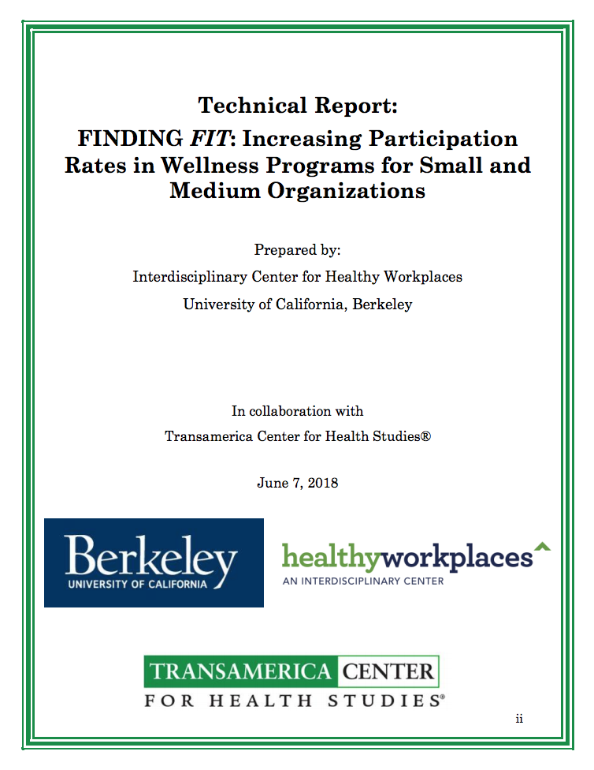
https://healthyworkplaces.berkeley.edu/sites/default/files/employer_guide_2018_03_30.pdf
https://healthyworkplaces.berkeley.edu/sites/
default/files/wwucbtechnical_final.pdf

Slide 54
Acknowledgements
We would like to thank Tony (Kwang Hyun) Kim, Pauline Simes, Max Pittman, Helen Lee, Mikaela Burns, Astrid Zamora, and Justine Yu for their contributions to this project.
We also sincerely thank Hector De La Torre and the Transamerica Center for Health Studies for their generous grant in support of this project.

Slide 55
Thank you.
https://healthyworkplaces.berkeley.edu/

